Slide 1
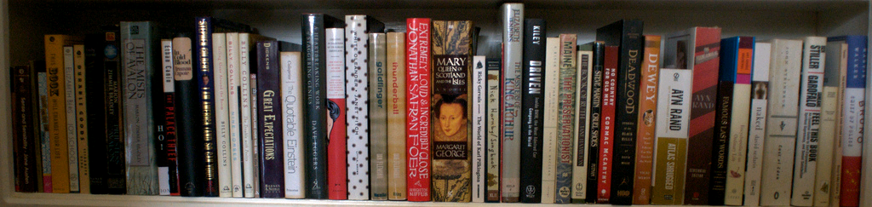

Welcome
image from Flickr User eloquentlight's photostream
http://library.reynolds.edu

Slide 2
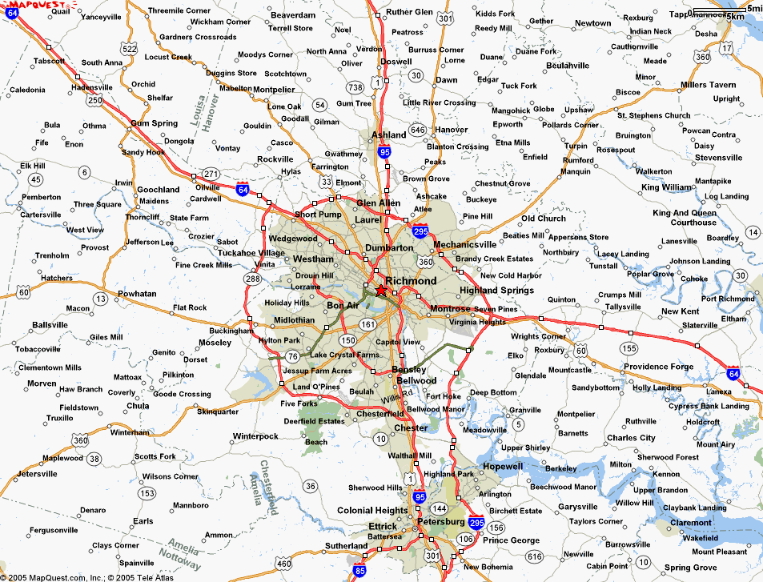
Where can you find us?
http://library.reynolds.edu
Goochland
Parham
Downtown

Slide 3
What do we have for you?
Books
Periodicals
Videos
Audio Books
Print: 90,000
Online: 40,000
Print: 400
Online: 50,000
DVDs: 3250
Online: 1000
Disc: 700
Online: 8750
Other Collections:
ESL
Career
Juvenile
Graphic
Educational & Popular
Notes:
According to the survey conducted by OCLC….

Slide 4
Books
Total: 130,000
Sign up for Books Unlimited workshop to learn more about reading and downloading ebooks …

Slide 5
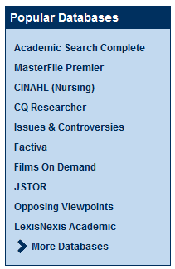
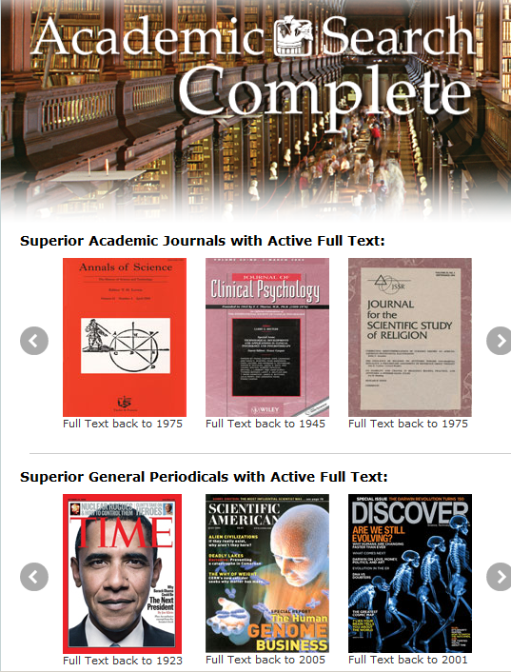
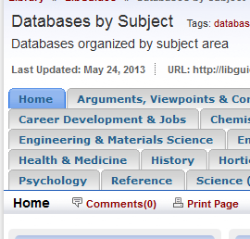
Periodicals

Slide 6
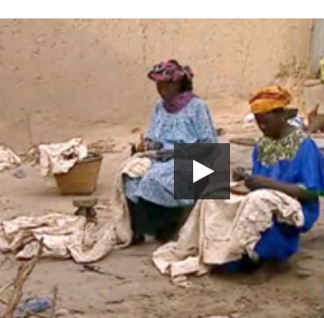
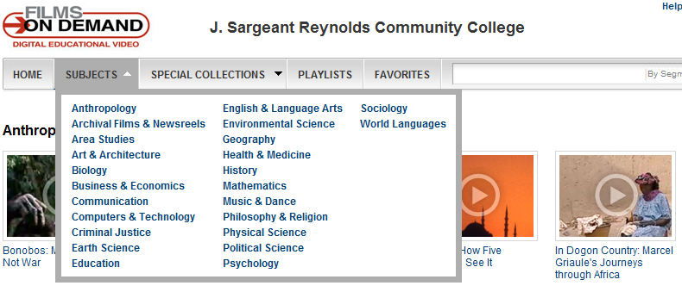
Videos: Online & DVD
Over 8750 online educational videos & 3250 popular DVDs

Slide 7
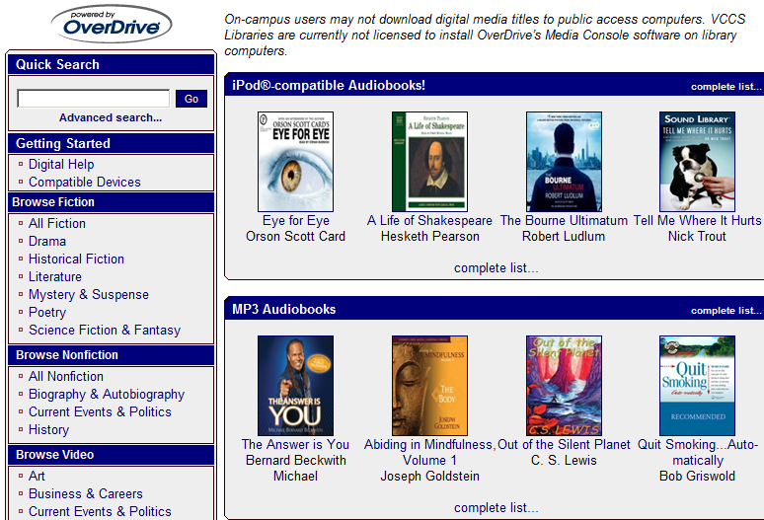
Audio Books: Online & Discs
Over 1000 online audio books with OverDrive and about 700 books on Discs

Slide 8
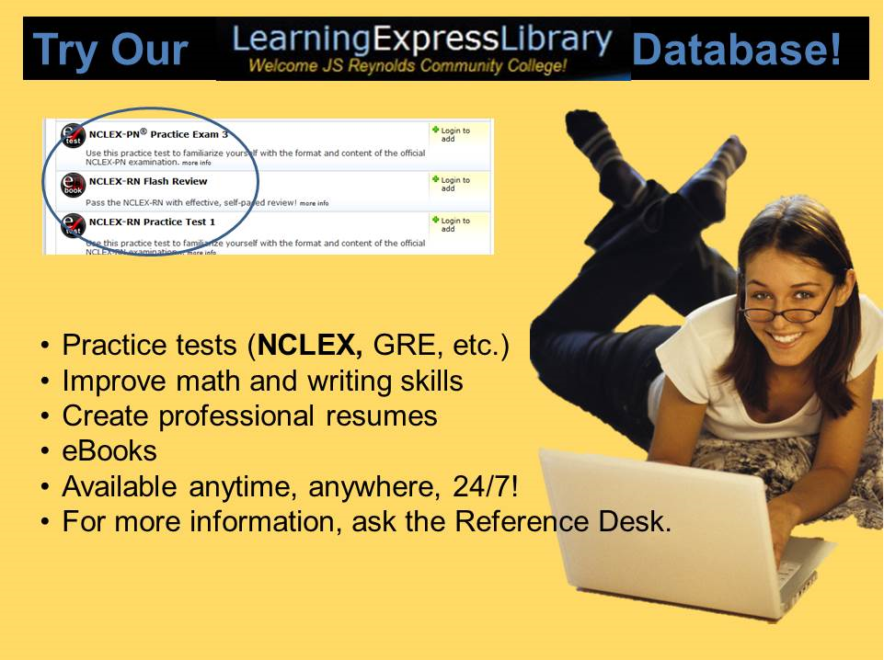

Slide 9


Slide 10

Library Card
Your Reynolds ID
is your library card!

Slide 11
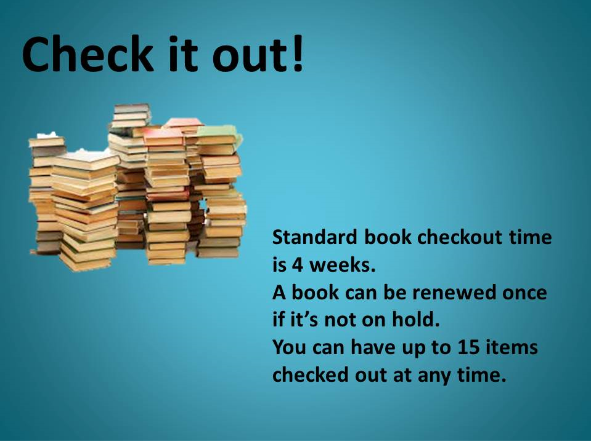

Check it out!

Slide 12

Reminder:
Students can access our online resources 24/7 from both on- and off-campus
“My Reynolds” login is the key to access our online databases from off-campus
Notes:
Image: http://www.123rf.com/photo_364562_around-the-clock.html
http://www.123rf.com/photo_1438015_gold-key-under-sun.html
Photo credit: http://www.onemedical.com/bos/how-we-work

Slide 13

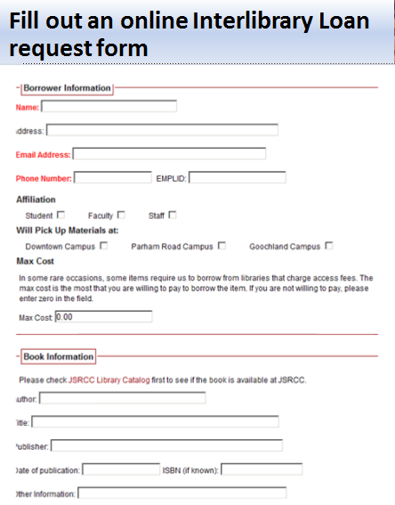
Beyond the Library…

Slide 14


Our Partner: RALC
Check out Books from a RALC Library with a RALC Pass

Slide 15


Our Partner:VIVA
Access tens of thousands of ebooks & journals with your MyJSRCC login from
A consortium of nonprofit academic libraries within the Commonwealth of Virginia. Members include all of the 39 state-assisted colleges and universities
Total funding for the 2012-13 year is $15.5 million, of which $7.4 million (48%) is from the Virginia General Assembly.

Slide 16




Our Partner:VCCS
Enjoy enhanced access to library and information resources in a cooperative and cost effective manner

Slide 17
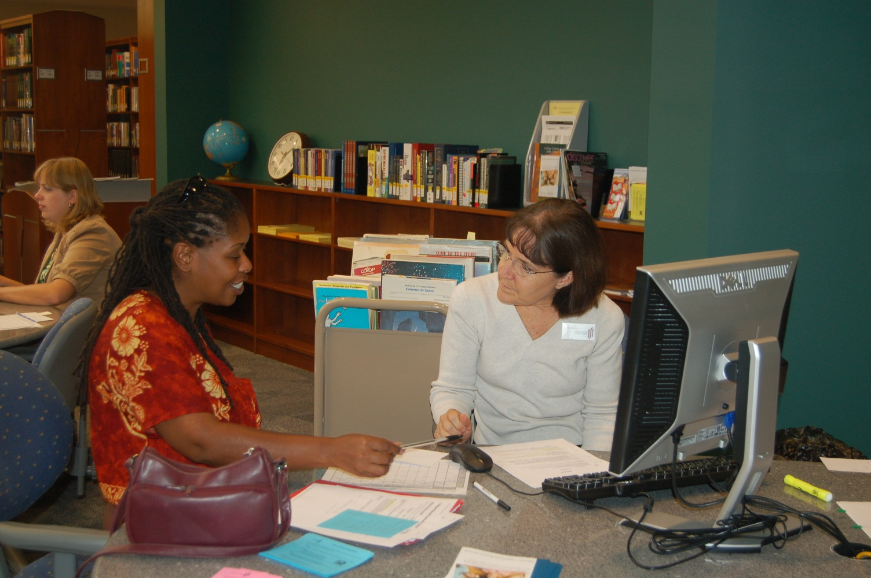
What can we do for you?
One-on-One Research Consultation

Slide 18

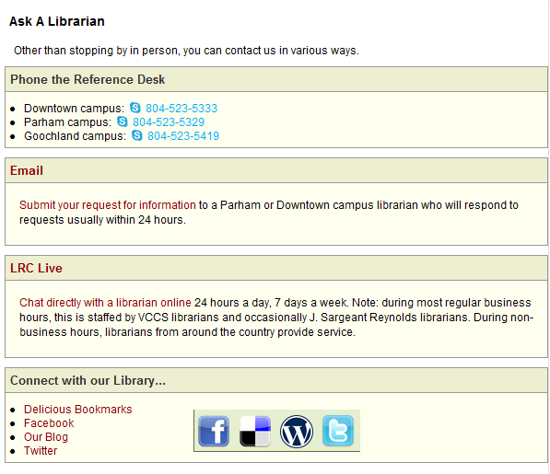
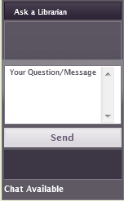
Stay connected with us online

Slide 19


Slide 20
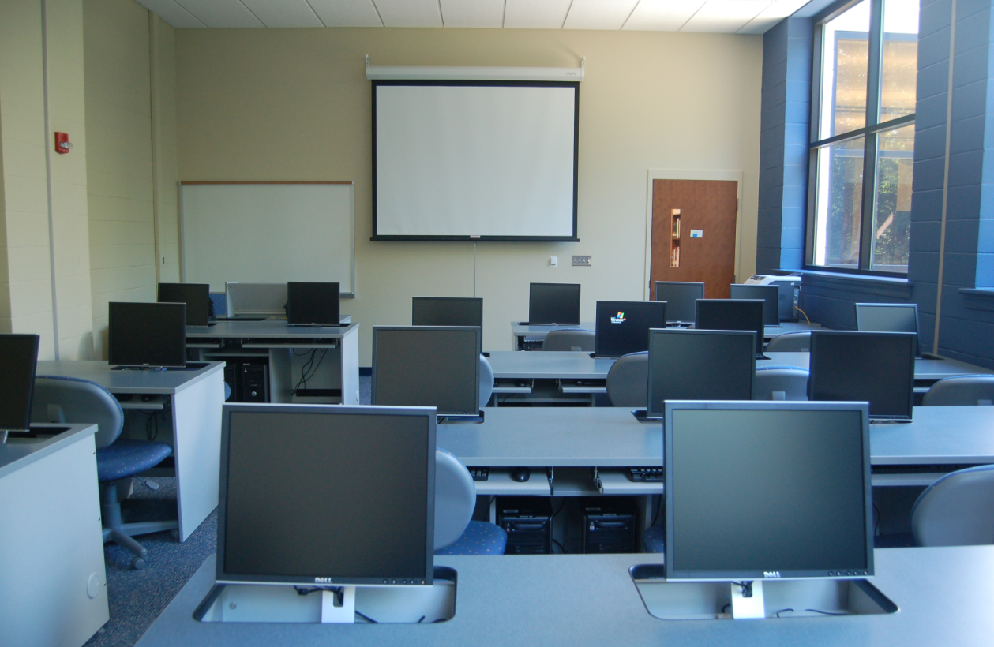
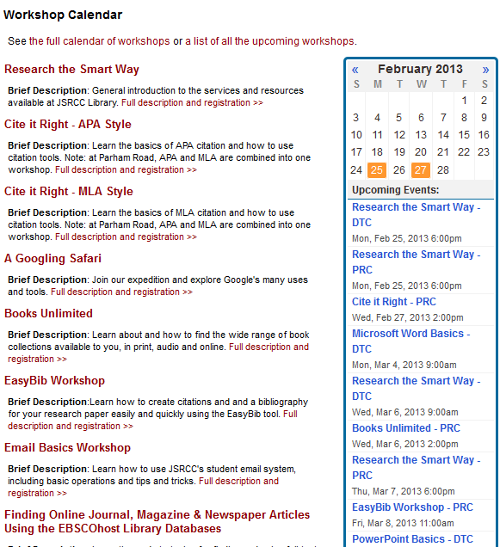
Open Session Library Workshops

Slide 21
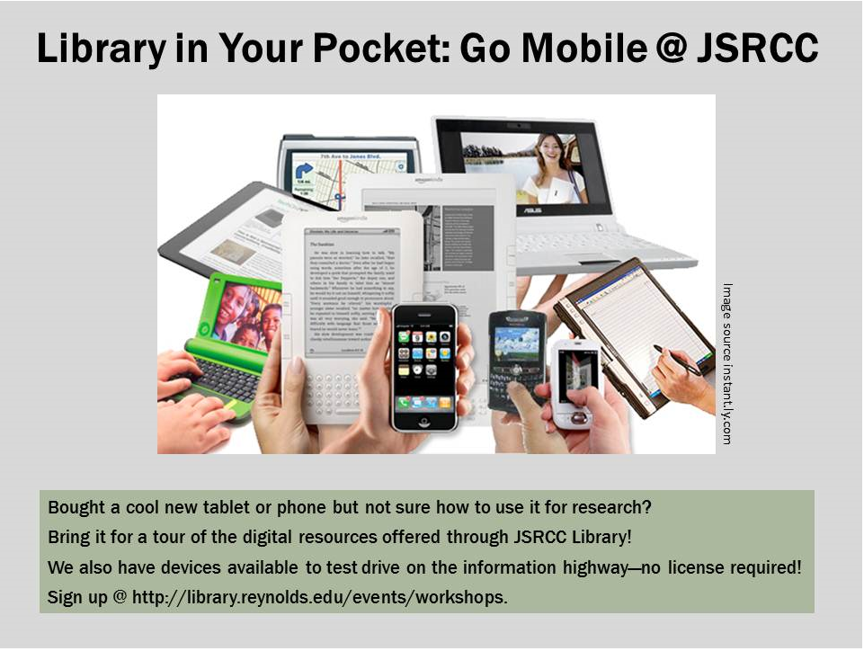

Slide 22
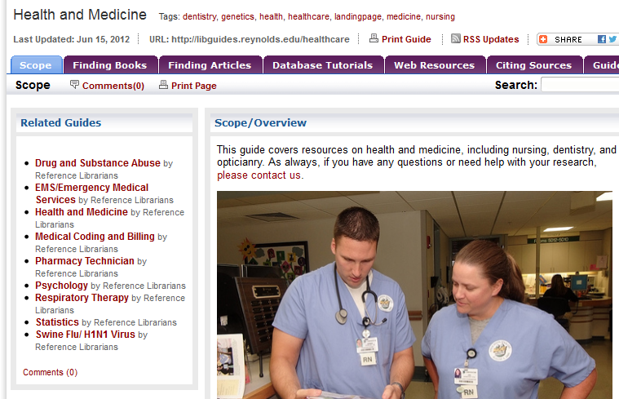
Course/Assignment/Subject-based LibGuides

Slide 23
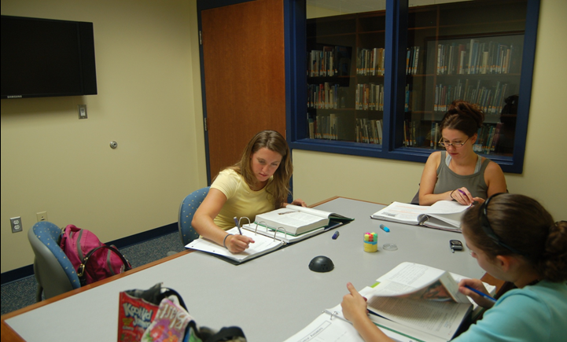
Group Study Rooms for Collaborative Projects
Eight at Parham; Three at DTC; One at GC

Slide 24
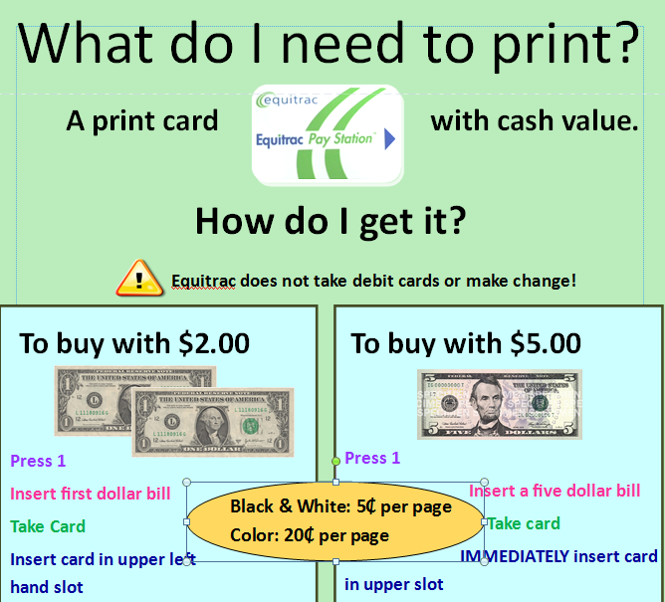
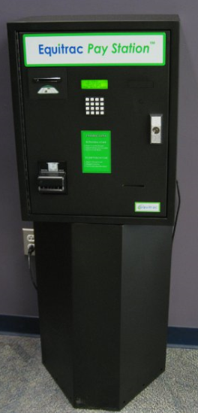
Printing

Slide 25

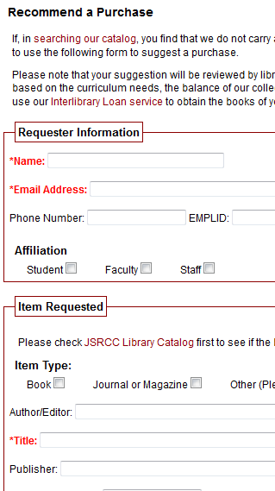
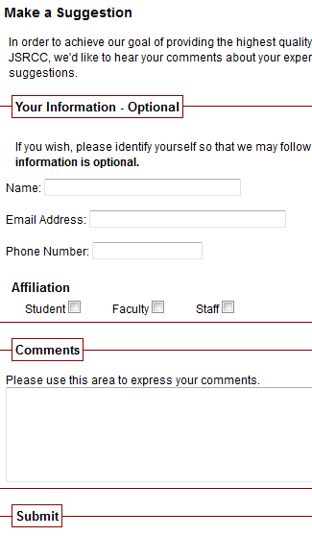
We welcome your feedback!
Notes:
Photo:http://www.kinesissurvey.com/kinesis-survey/customer-employee-feedback/

Slide 26
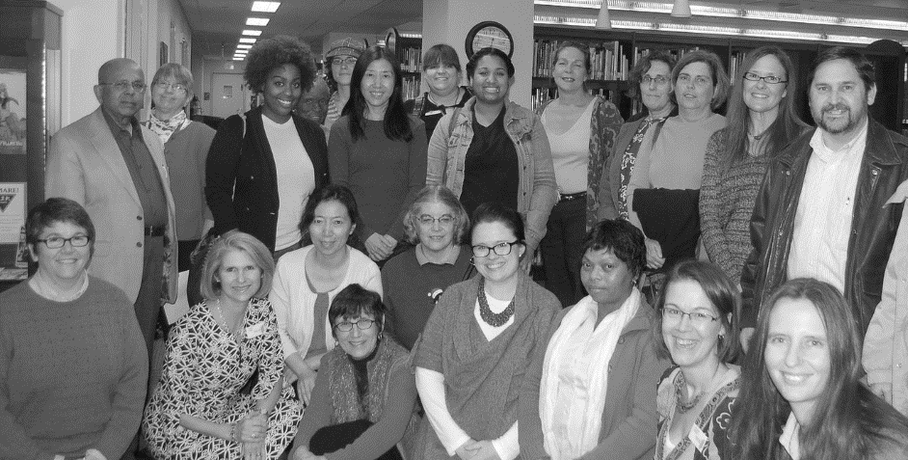
Thank You!
We are looking forward to helping you!
http://library.reynolds.edu

